Slide 1
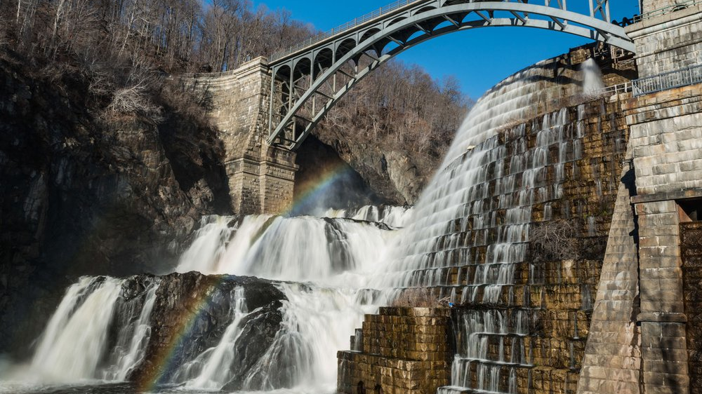
New York’s
Aqueduct/Water Transfer
Project

Slide 2
What is the problem?
Water sources back in 1664 was salt water that was underground
Sanitation was a problem with garbage being thrown in water supplies
Disease spread rapidly and caused many outbreaks due to no sewage system and access to clean water

Slide 3
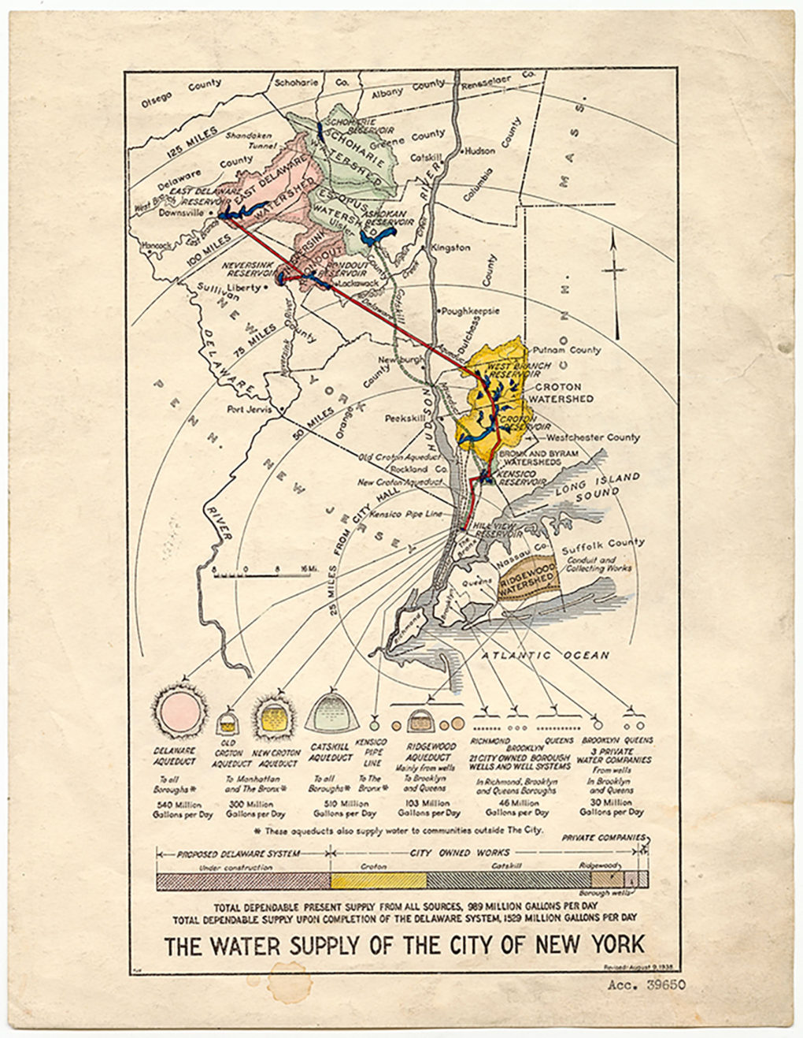
What is being done?
An aqueduct was proposed and voted on to allow water from Croton River (40 miles north)
It was finished in 1848 and when cholera emerged again in 1849, they built a sewer system
A larger aqueduct was built to meet the demand of over one million residents in the 1890s
The New York City water supply system, 1938. [NYC Water © Flickr, courtesy DEP NYC]

Slide 4
The Actions
Transporting water from afar was the hardest and most costly start for access to clean water
The Delaware water project cost over $300 million to build which was an 85 miles long tunnel from the Rondout Reservoir

Slide 5
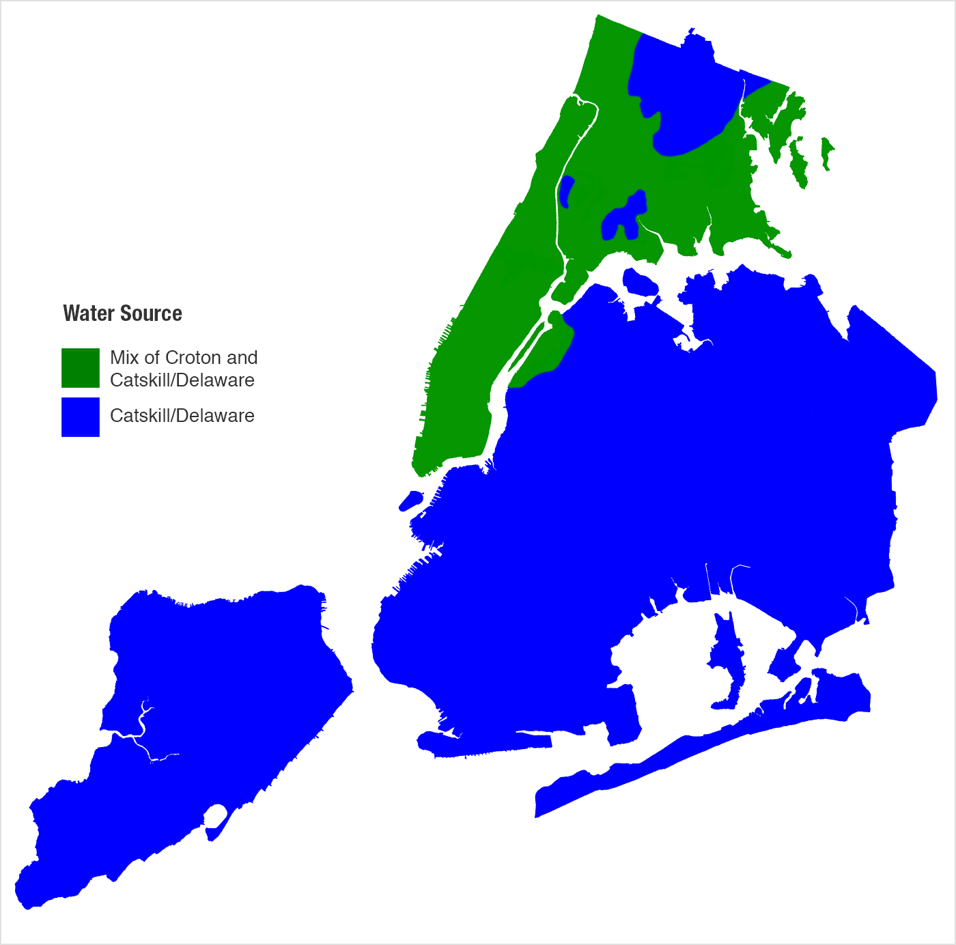
Was it Successful?
The Catskill Aqueduct is the biggest aqueduct in New York
Supplies clean water to millions of people
A $1 billion project to repair the Catskill Aqueduct
A map of the Current Water Distribution

Slide 6
Sources
“Water Distribution Changes for Important Aqueduct Project.” The Official Website of the City of New York, 12 Oct. 2021, https://www.nyc.gov/site/dep/news/121021/water-distribution-changes-important-aqueduct-project
Magazine, Smithsonian. “How New York City Found Clean Water.” Smithsonian.com, Smithsonian Institution, 25 Nov. 2019, https://www.smithsonianmag.com/history/how-new-york-city-found-clean-water-180973571/
Sante, Lucy. “An Enduring Source of Drinking Water.” Places Journal, 1 Nov. 2020, https://placesjournal.org/article/reservoir-an-enduring-source-of-drinking-water/?cn-reloaded=1

